Slide 1
Towards Seasonal Forecasts
Avaialbility of VarEPS Reorecasts (% Members, started once every Week)
1961 1971 1981 1991 2001 2011
IFS-(Var)EPS re-forecasts
Medium-to-extended range forecast of available water resources with PREVAH
Estimation of deviation from climatological mean (focus on water scarcity and low-flows)
Day0 Day+5 Day+10 Day+30 Day+90
IFS-(Var)EPS
Observed climatology

Slide 2
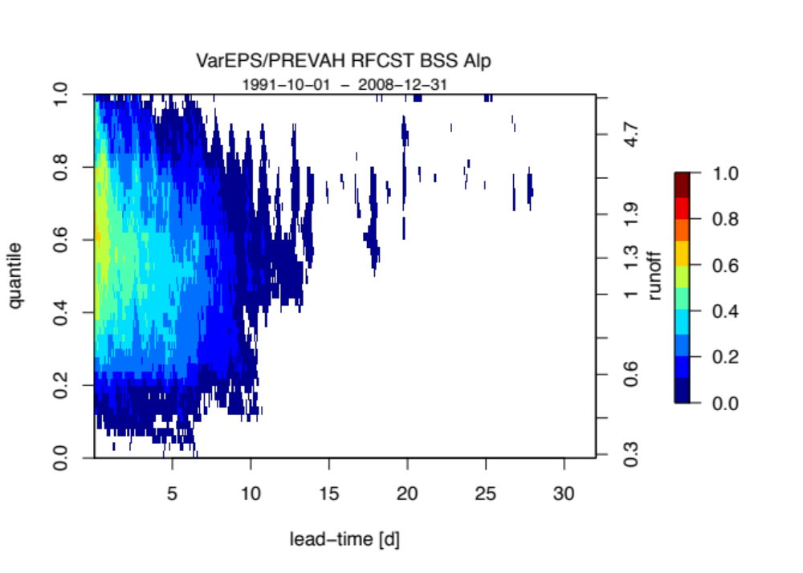
Skill of ECMWF VarEPS monthly reforecasts
Kein Skill nach 10 Tagen
Wie verifizieren (mehr)tägliche Abflussprognosen?

Slide 3
Drought Indices
runoff
duration
Mean monthly runoff
MMR
threshold
severity
lead-time
duration = length of longest forecast period below MMR
severity = cumulative runoff deficit w.r.t. MMR
Magnitude = severity/duration
Calculated for each monthly forecast (weekly issued, 1991-2008),
5 members and according observations
Results are ensemble forecasts of indices & verification

Slide 4
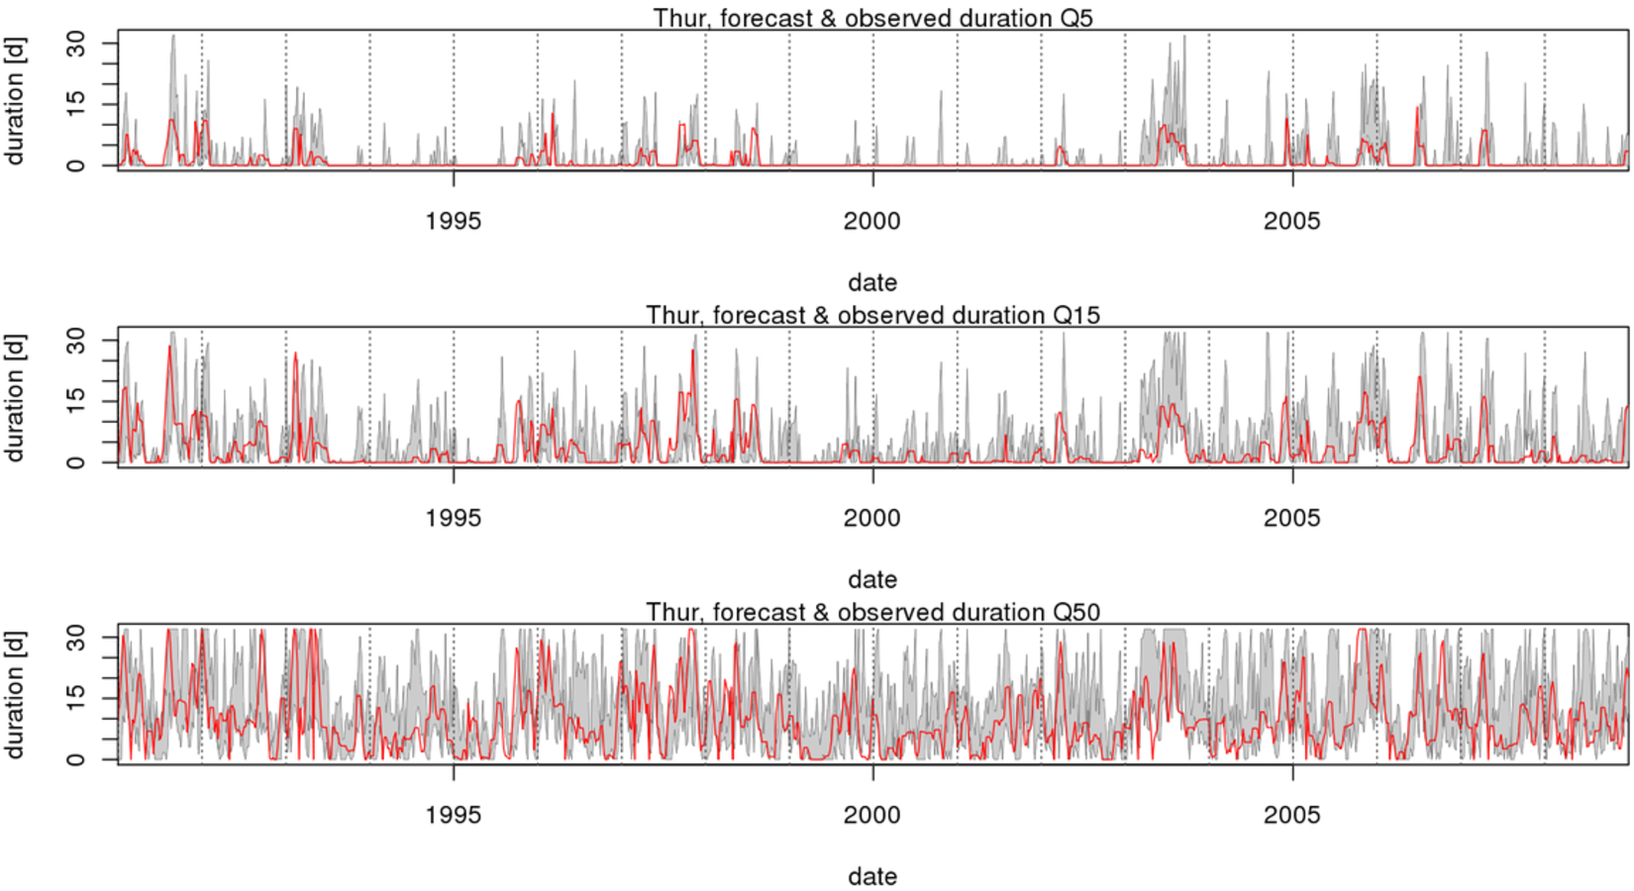
Low-Flow Duration

Slide 5
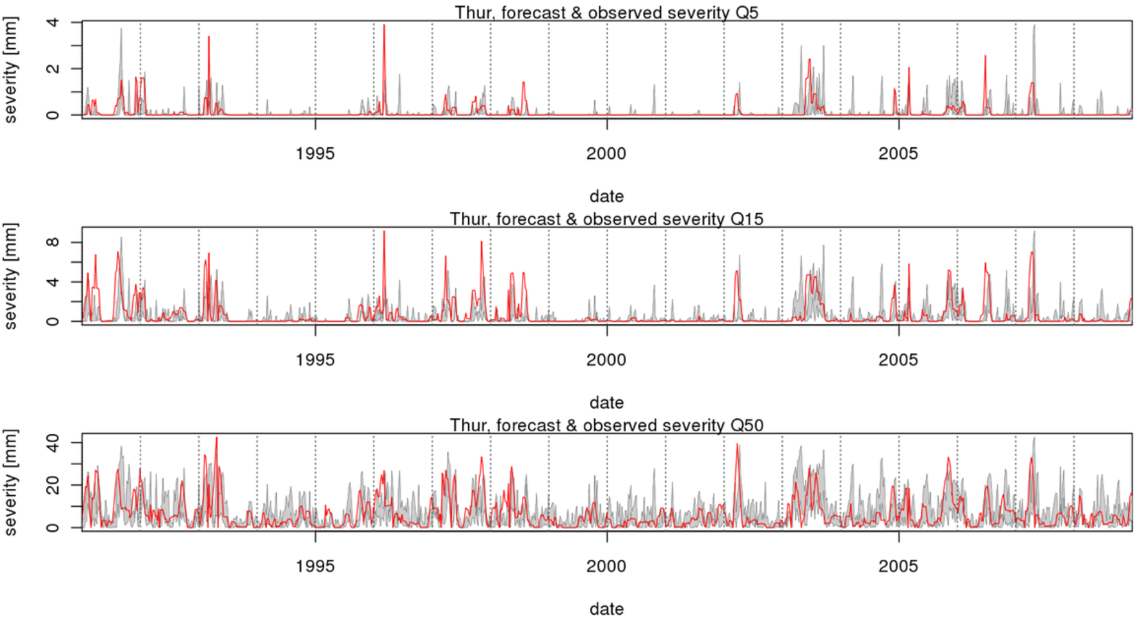
Low-Flow Severity

Slide 6
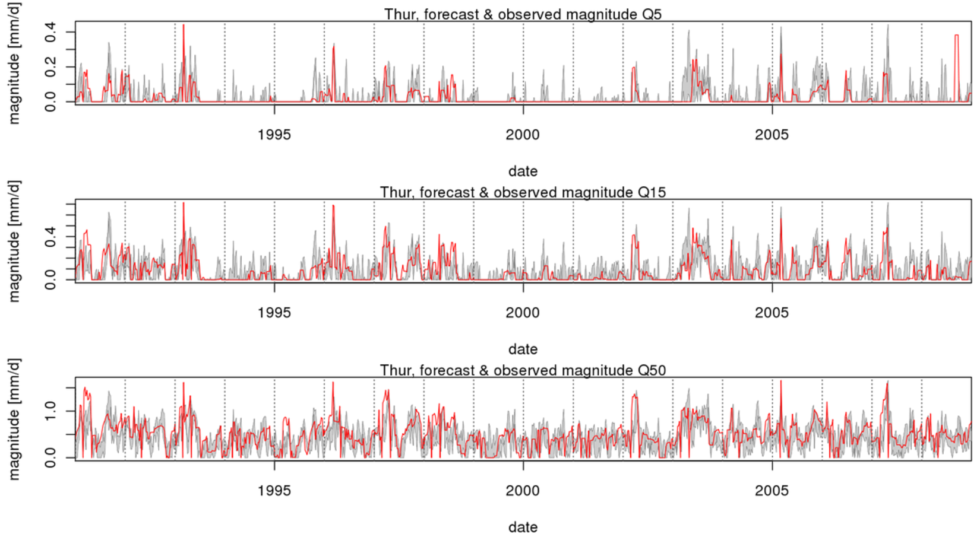
Low-Flow Magnitude

